Slide 1
Euler Path And Euler Circuit
Presented by : Shiva kumar
Roll No: 227r1a05j3
Section : cse (c )

Slide 2
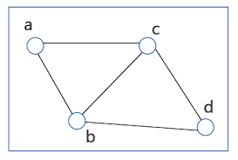
Introduction to Graph Theory
What is Graph Theory
Graph: A set of vertices (nodes) connected by edges.
Vertex: A node in the graph.
Edge: A connection between two vertices.

Slide 3
Euler Path and Euler Circuit
Euler Path:
A path that visits every edge of a graph exactly once.
A graph has an Euler Path if and only if:
Visit each edge of the graph exactly onces.
Start and end vertex are different
Vertex can be repeated but edge can’t be
Atmost 2 vertex have odd degree

Slide 4
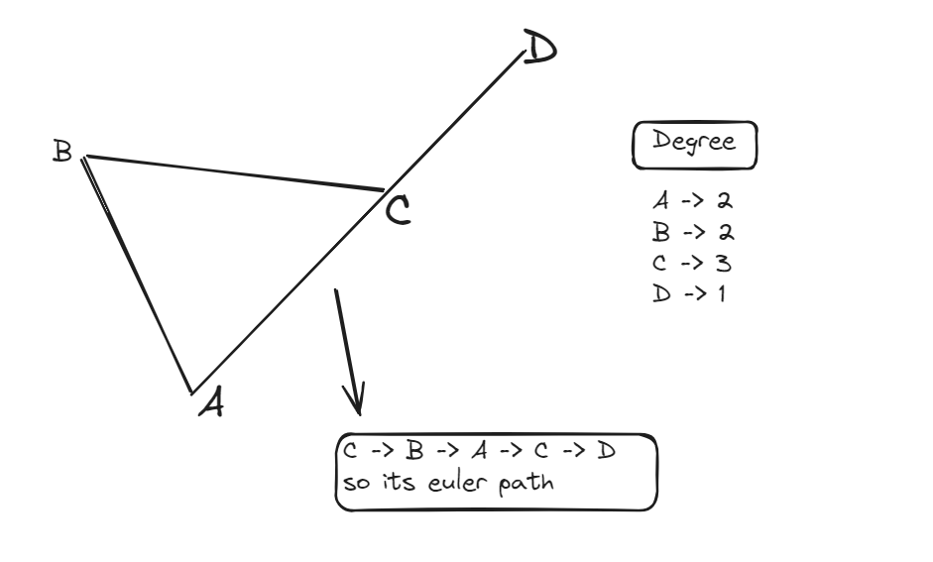
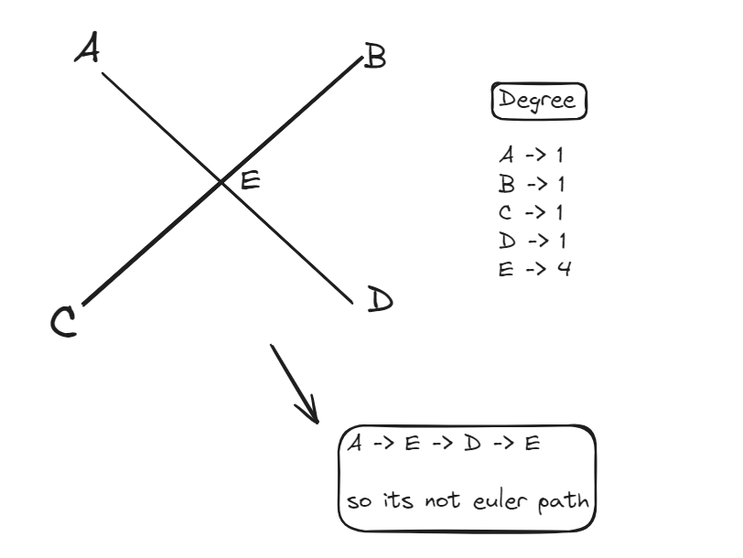
Example of Euler path:
Example 1:
Example :-2

Slide 5
Euler Circuit
Euler Circuit (Eulerian Cycle):
A circuit that visits every edge of a graph exactly once and returns to the starting vertex.
A graph has an Euler Circuit if and only if:
Visit each edge of the graph exactly onces.
Start and end vertex are same
Vertex can be repeated but edge can’t be
Each vertex degree is even

Slide 6
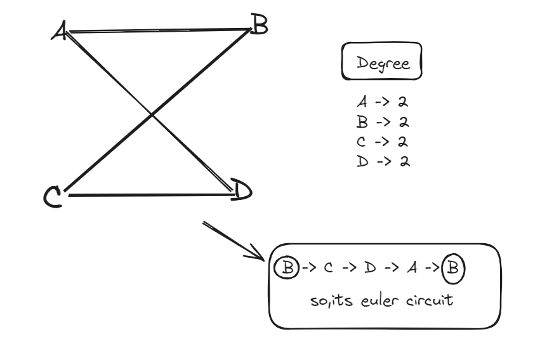
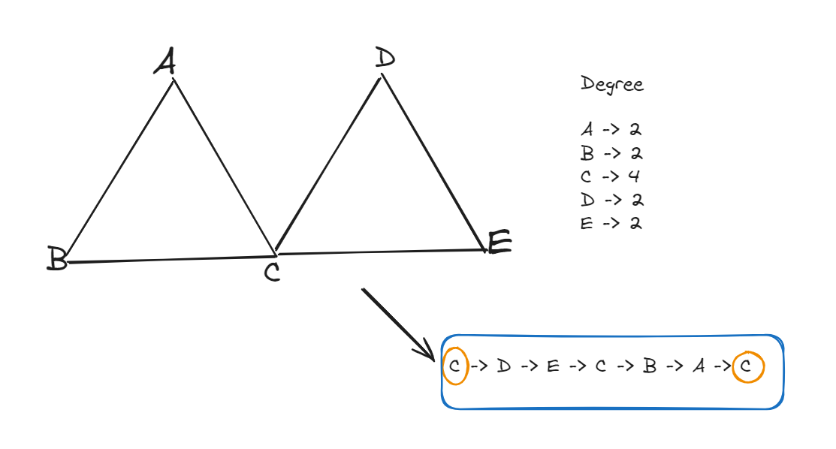
Example of Euler circuit:
Example 1
Example 2

Slide 7
Algorithms to Find Euler Paths and Circuits
Fleury’s Algorithm:
Step-by-step edge removal.
Hierholzer’s Algorithm:
Finding Eulerian circuits in directed graphs.

Slide 8
Real-World Applications
Urban Planning:
Street sweeping, garbage collection routes.
Network Design:
Routing problems in telecommunications.
DNA Sequencing:
Finding Eulerian paths in genome assembly.

Slide 9


